Slide 1


CONTROL SYSTEM DESIGN FOR DISTURBANCE REJECTION IN ACTIVE VIBRATION CONTROL SYSTEMS
Alireza Mounesisohi
Committee Chair:
Dr. Saeid Bashash
Committee members:
Dr. Fred Barez and Dr. Ali Rahimi
Mechanical Engineering San Jose State University
Fulfilment of ME295B
May 2017
Notes:
Hello lady and gentlemen, dear chairman and committee members. thanks for taking your time and opportunity to present my research work, which is for fulfilment of my ME course. I would like to thank Dr Bashash for his insightful advices and help and all my colleagues and friends in the laboratory.

Slide 2

PERSONAL BACKGROUND
San José State University | A. Mounesisohi | May 2017 1
Bachelor of Science: Mechanical Engineering- Iran University of Science and Technology (2010-2014)
Senior project on Carbon Nanotubes (CNTs),
Finite element analysis, programming, and optimizing through Matlab.
Master of Mechanical Engineering - San Jose State University (2016- EGD: May 2017)
Design and Graphics course Teaching Assistant
Control Systems Laboratory Research Assistant
Admitted to the doctoral program at UC Davis department of Mechanical Engineering (Fall 2017)

Slide 3
PRESENTATION OUTLINE
San José State University | A. Mounesisohi | May 2017 2
Introduction and literature review
Project objective
Methodology
Experimental development
Plant characterization
Control design
Controller optimization
Results and discussion
Conclusion
Notes:
I will talk for 30min and will include

Slide 4
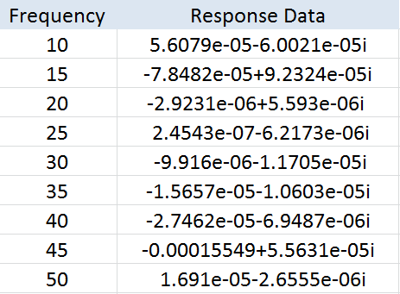
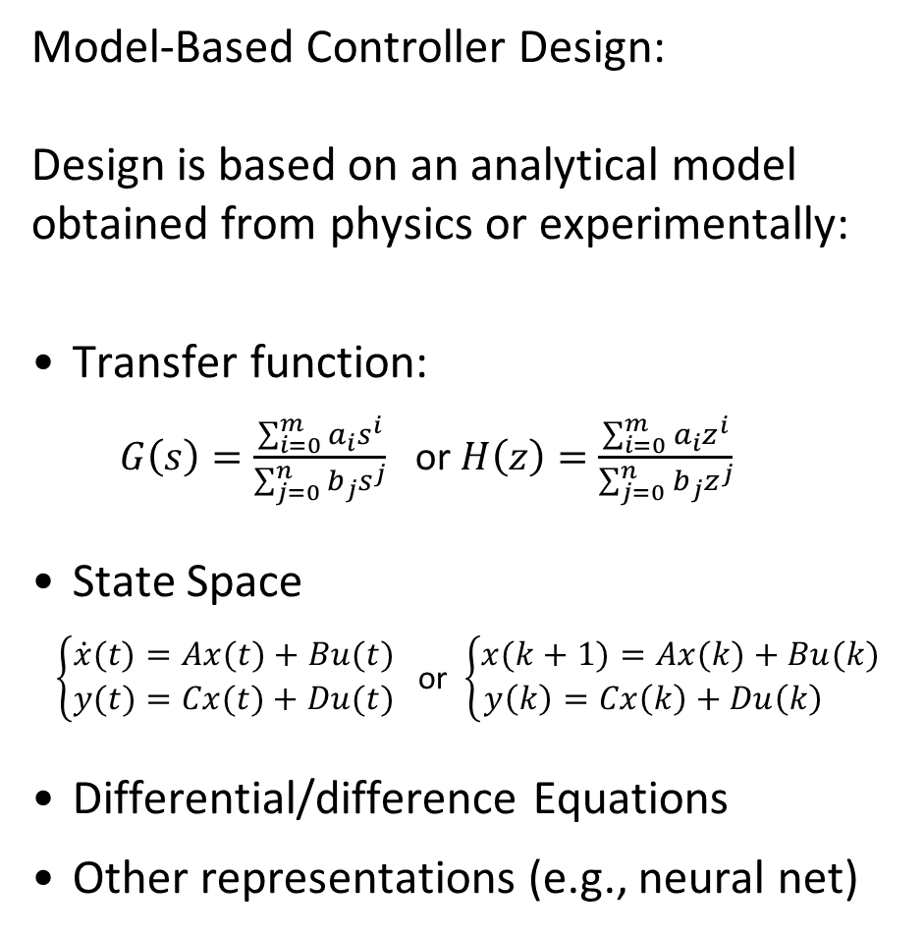
Introduction: Data-driven vs Model-based Control
Model-Based Controller Design:
Design is based on an analytical model obtained from physics or experimentally:
Transfer function:
$G\left(s\right)=\frac{\sum_{i=0}^{m}{a_{i}s^{i}}}{\sum_{j=0}^{n}{b_{j}s^{j}}}$ or $H\left(z\right)=\frac{\sum_{i=0}^{m}{a_{i}z^{i}}}{\sum_{j=0}^{n}{b_{j}z^{j}}}$
State Space
$\left\{\begin{aligned}\dot{x}(t)=Ax(t)+Bu(t) \\ y(t)=Cx(t)+Du(t)\end{aligned}\right.$ or $\left\{\begin{aligned}x(k+1)=Ax(k)+Bu(k) \\ y\left(k\right)=Cx\left(k\right)+Du\left(k\right) \end{aligned}\right.$
Differential/difference Equations
Other representations (e.g., neural net)
Data-based (Data-driven) Controller Design:
Design is based on a set of frequency response data (In this project):

Slide 5
Advantages and Disadvantages of Data-driven Method
Disadvantages:
Lack of insight into the physics of the system
Non-conventional design (Frequency domain design vs. standard pole placement, LQR, etc.)
Requirement for great level of expertise in the frequency domain design
Requires frequency-domain data, which could be more challenging to collect compared to time domain data.
Advantages:
No need for model development (which could take up to 75% of the total design time [18])
No need for model identification
No modeling errors (Almost exact)
Scalable to a large plant population (useful consumer products, e.g., HDDs, smart phone cameras, etc.)
Ability to accommodate numerous design objectives (stability, performance, robustness)

Slide 6
Literature Review of Vibration Control Systems
Model-based controller design
[1] S. Khot, N. P. Yelve, R. Tomar, S. Desai, and S. Vittal, "Active vibration control of cantilever beam by using PID based output feedback controller," Journal of Vibration and Control, vol. 18, pp. 366-372, 2012.
Developed an FEM-based model of a beam in ANSYS, and designed a PID controller
[2] T. Zhang, H. G. Li, G. P. Cai, and F. C. Li, "Experimental verifications of vibration suppression for a smart cantilever beam with a modified velocity feedback controller," Shock and Vibration, vol. 2014, 2014.
Used Hamilton’s principle to develop a model of a flexible beam, and velocity feedback and extended observer for controller design.
[3] M. S. Saad, H. Jamaluddin, and I. Z. M. Darus, "Active vibration control of a flexible beam using system identification and controller tuning by evolutionary algorithm," Journal of Vibration and Control, vol. 21, pp. 2027-2042, 2015.
Used Auto-regressive system identification, and genetic algorithm to tune a PID controller. Results better than PID tuned based on Ziegler Nichols

Slide 7
Literature Review of Vibration Control Systems
Model-based controller design (continued)
[4] S. Bashash, K. Vora, and N. Jalili, "Distributed-parameters modeling and control of rod-type solid-state actuators," Journal of Vibration and Control, vol. 17, pp. 813-825, 2011.
Developed a state-space model using Hamilton’s principle, and developed a nonlinear sliding mode controller with state observer and state controller.
[5] M. Dadfarnia, N. Jalili, Z. Liu, and D. M. Dawson, "An observer-based piezoelectric control of flexible Cartesian robot arms: theory and experiment," Control Engineering Practice, vol. 12, pp. 1041-1053, 2004.
Used Lyapunov theory to develop an observer-based feedback controller for a rotating cantilever beam.
[6] E. Omidi and S. N. Mahmoodi, "Active vibration control of structures using a leader–follower-based consensus design," Journal of Vibration and Control, p. 1077546316631896, 2016.
Used consensus control theory to develop multi-variable feedback controller for flexible beams.

Slide 8
Literature Review of Vibration Control Systems
Data-based controller design
[7] A. Karimi and Y. Zhu, "Robust H∞ Controller Design Using Frequency-Domain Data," IFAC Proceedings Volumes, vol. 47, pp. 4921-4926, 2014.
Developed a robust H_{inf} controller based on a set of input output plant data and proved the boundedness of the closed-loop system norm.
[8] S. Formentin, S. Savaresi, and L. Del Re, "Non-iterative direct data-driven controller tuning for multivariable systems: theory and application," IET control theory & applications, vol. 6, pp. 1250-1257, 2012.
Developed multivariable data-driven controller based on the Virtual Reference Feedback Tuning (VRFT).
[9] S. Bashash, "Robust control optimization for high performance track following in hard disk drives," in American Control Conference (ACC), 2015, 2015, pp. 4634-4639.
Developed a data-driven controller using numerical optimization of the closed-loop system properties for hard disk drives.

Slide 9
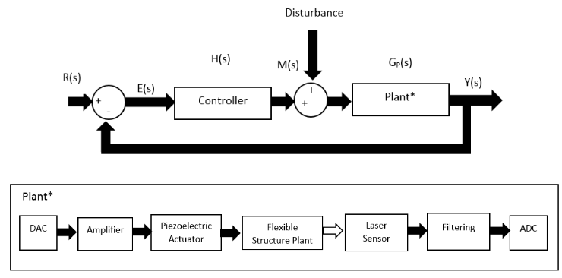
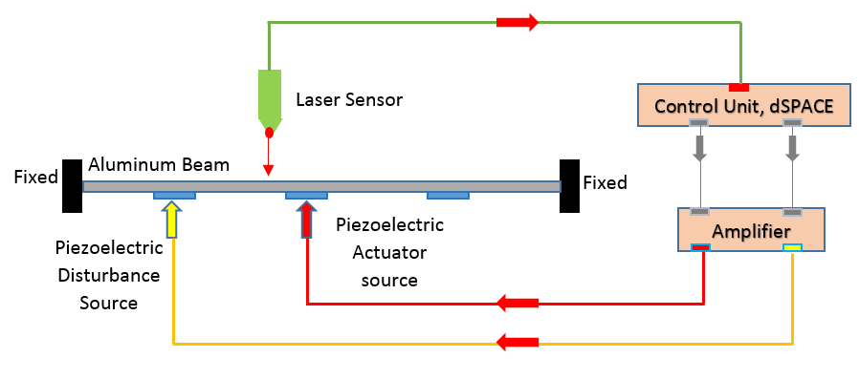
OBJECTIVES OF THE STUDY
San José State University | A. Mounesisohi | May 2017 4
Developing an experimental testbed for active vibration control testing at SJSU Control Systems Lab.
Development and experimental implementation of a sample data-driven controller for reference following and disturbance rejection
Figure 1: Experimental setup configuration
Figure 2: Block diagram of the control system of the study

Slide 10
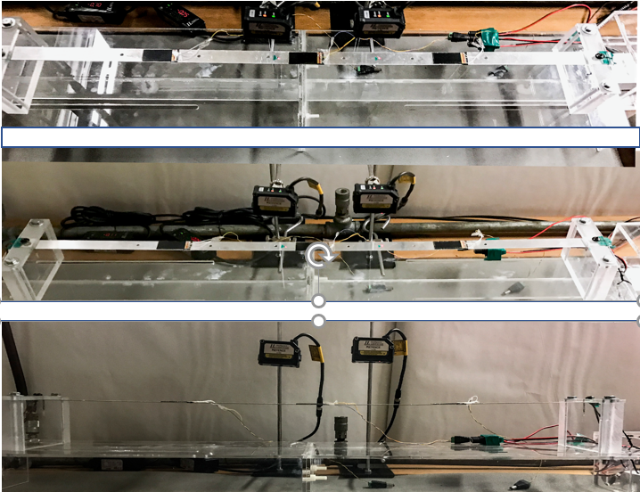
EXPERIMENTAL SETUP
San José State University | A. Mounesisohi | May 2017 5
EXPERIMENT
Top View
The experimental setup comprises a clamped-clamped beam holder, an aluminum beam, a set of piezo patch actuators, a voltage amplifier, laser sensors and a controller board.
Lateral View
DEVICE | BRAND | SPECs
Control Unit | dSPACE | 100 kHz sampling rate
Amplifier | Piezo Master | Gain is 20
Laser Sensor | Keyence | 3.3 kHz sampling rate
Piezoelectric | American Piezo | -100 to +100 volts
Front View
Table 1: Devices, brands, and specs of the experimental setup components
Figure 3: Beam, lasers, and piezoelectric actuator’s standing positions in the experimental setup from different angles.

Slide 11
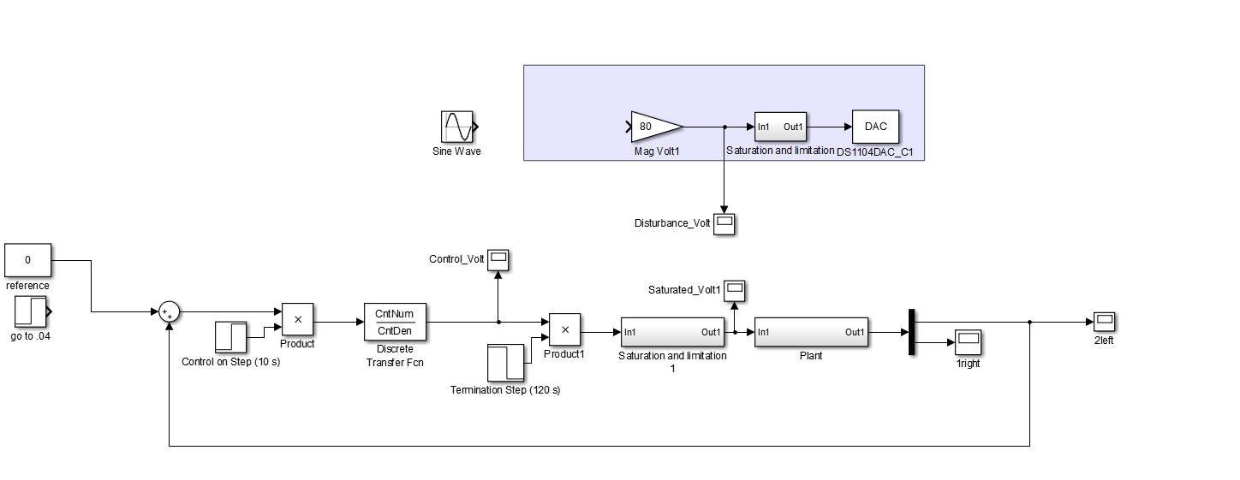
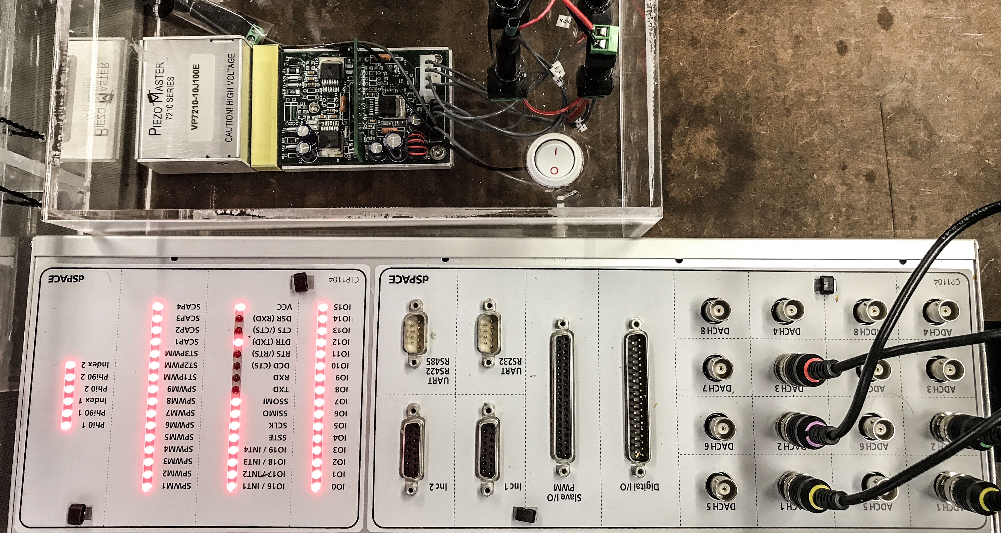
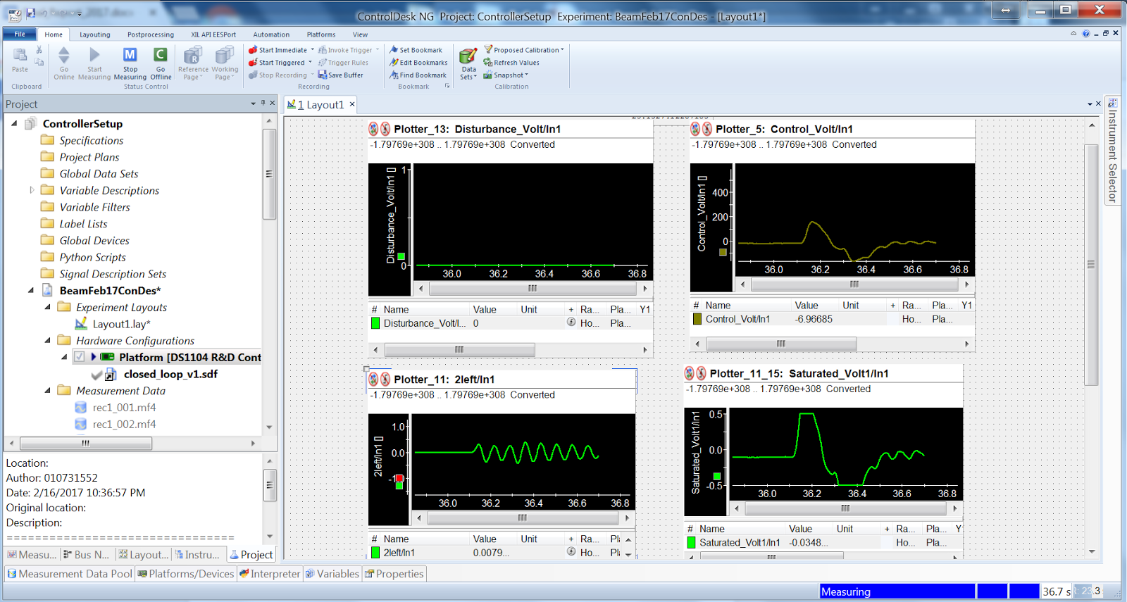
EXPERIMENTAL SETUP
EXPERIMENT
Fig. 4 Simulink, Control desk, and dSPACE board
San José State University | A. Mounesisohi | May 2017 5

Slide 12
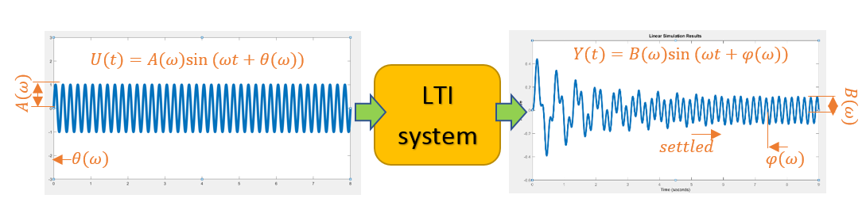
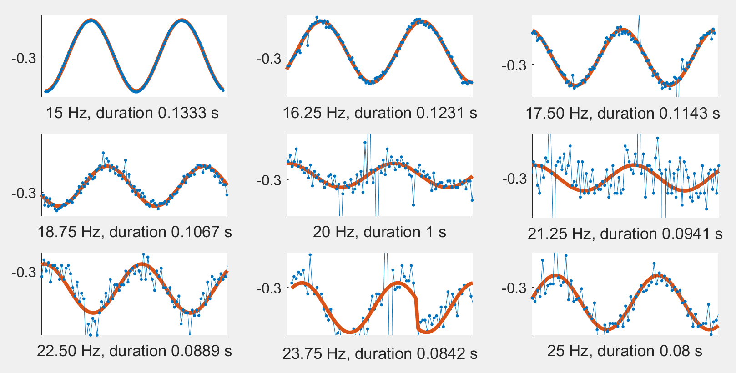
San José State University | A. Mounesisohi | May 2017 7
PLANT CHARACTERIZATION
OGY
Sinusoidal voltage inputs were given and displacement outputs were collected.
Using least squares optimization, sine trajectories were fit to noisy output data, and magnitude and phase responses were computed.
Figure 5: LTI system behavior and sine function fitting the steady-state portion of the output

Slide 13
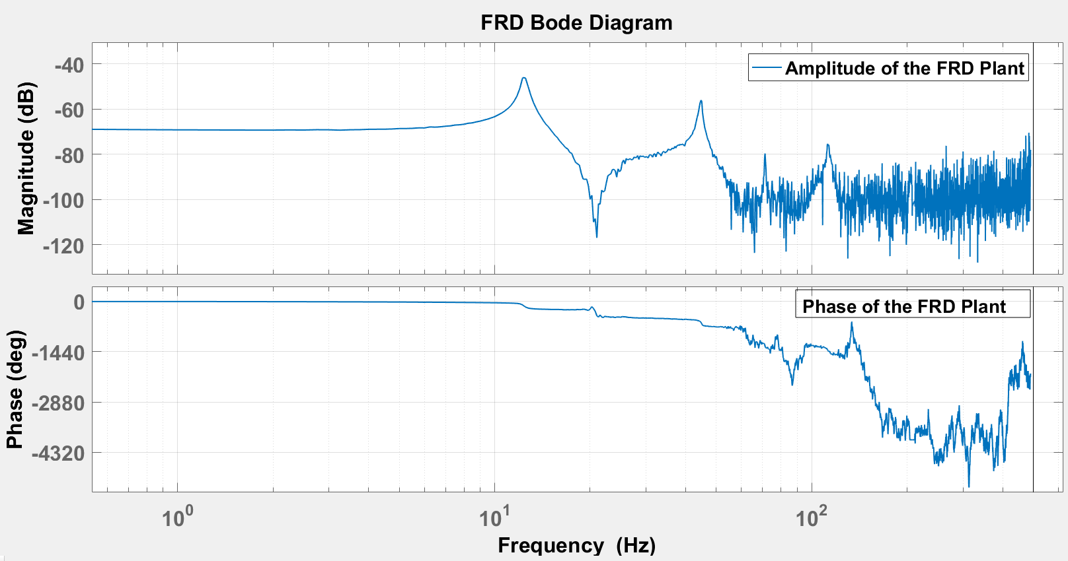
San José State University | A. Mounesisohi | May 2017 9
PLANT CHARACTERIZATION
The obtained frequency response plot within 0-500 Hz.
Figure 6: Bode plot of the data-driven frd object or plant.

Slide 14
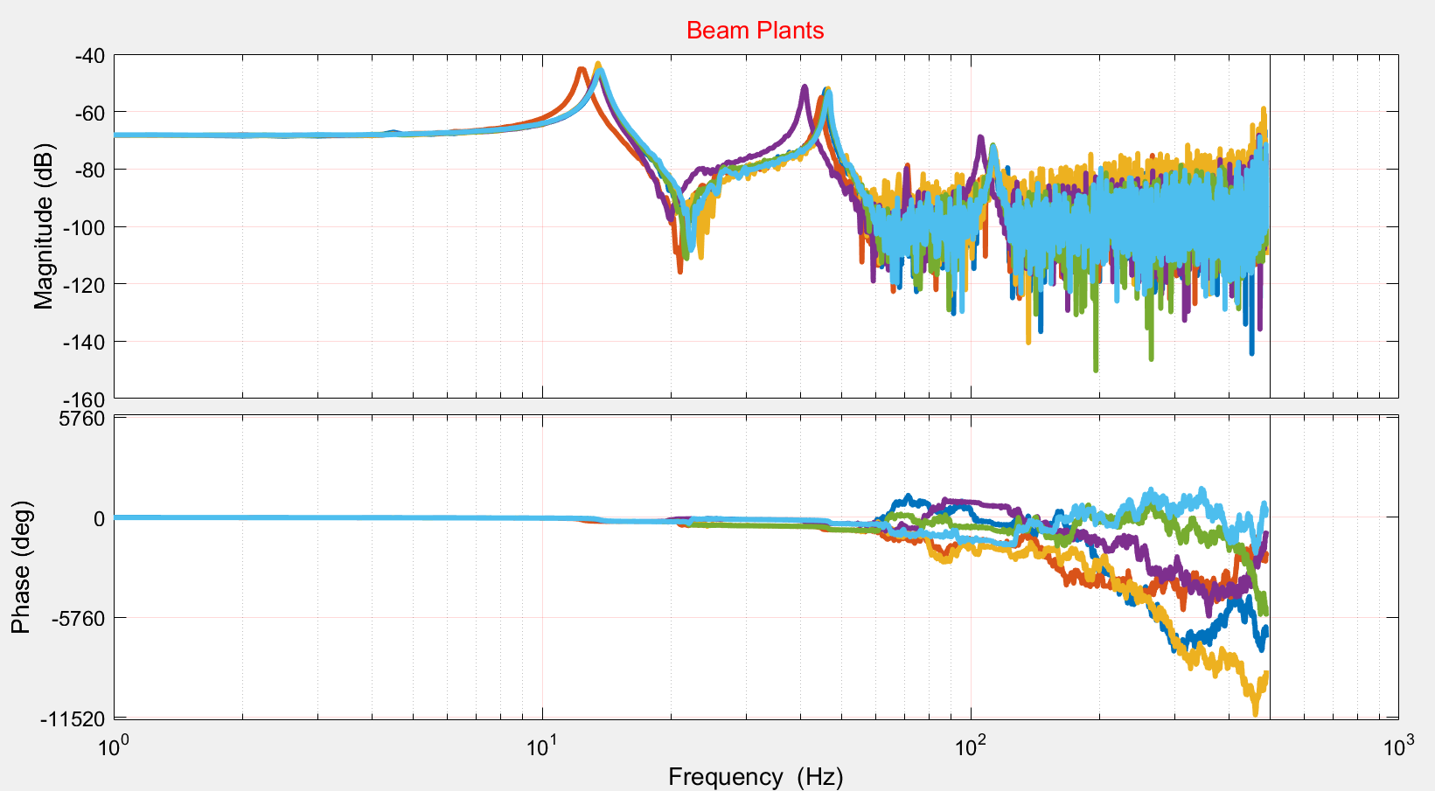
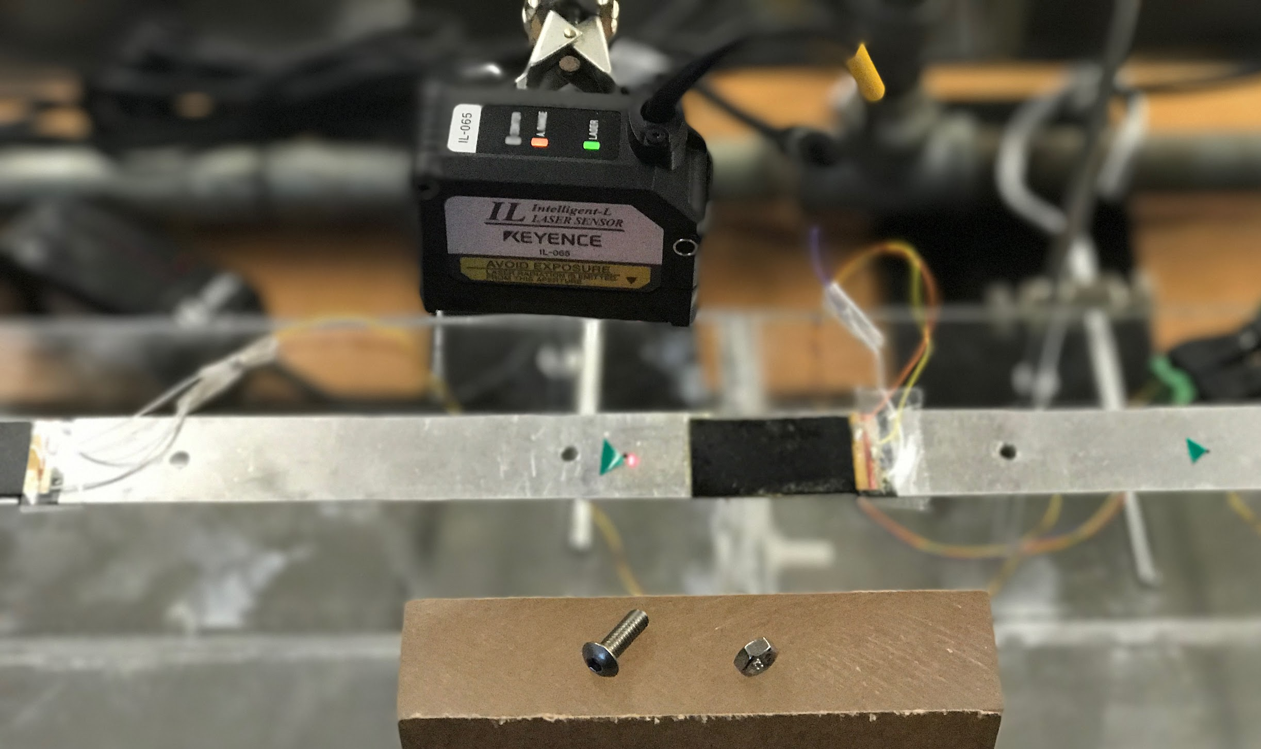
Family of Plants
San José State University | A. Mounesisohi | May 2017 11
PLANT CHARACTERIZATION
METHODOLOGY
To enhance robustness more plants are needed.
A family of six different plants are collected by adding a small screws on the beam at different locations.
Figure 8: Collected Plant frequency response plots by attaching a screw at different locations on the beam
Figure 7: Adding mass to the beam by nuts and screws.

Slide 15
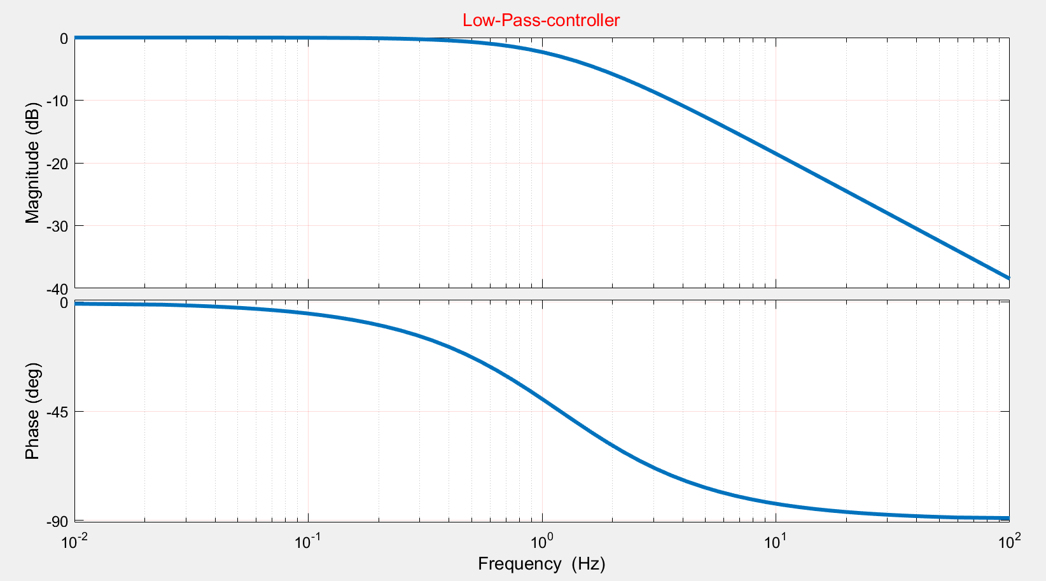
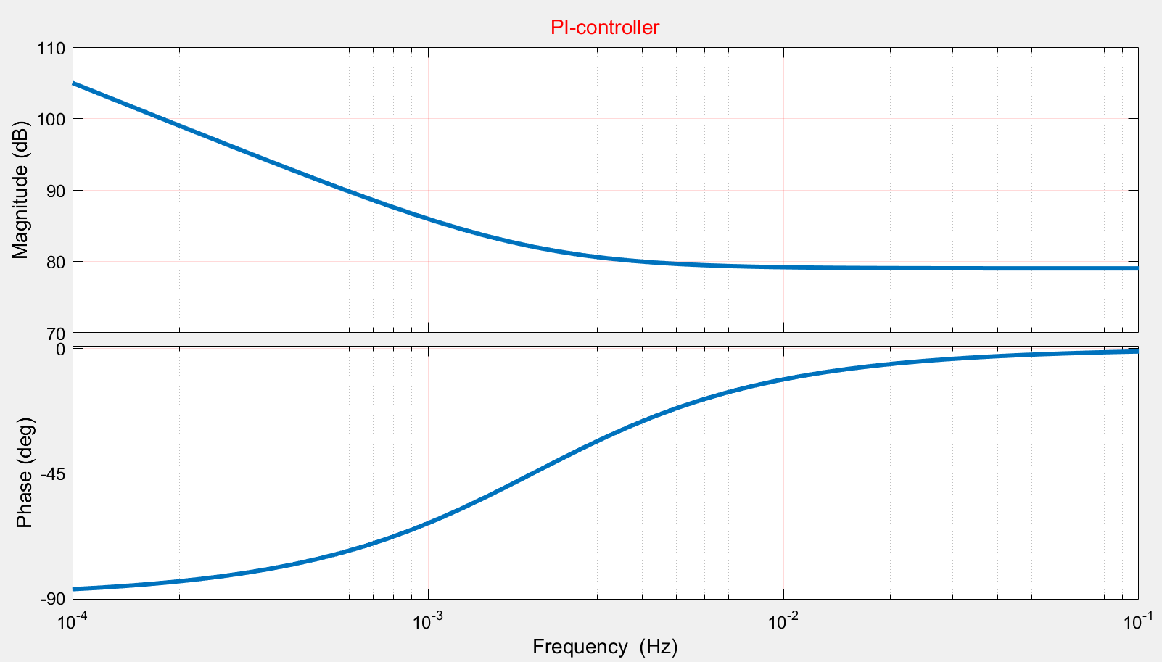
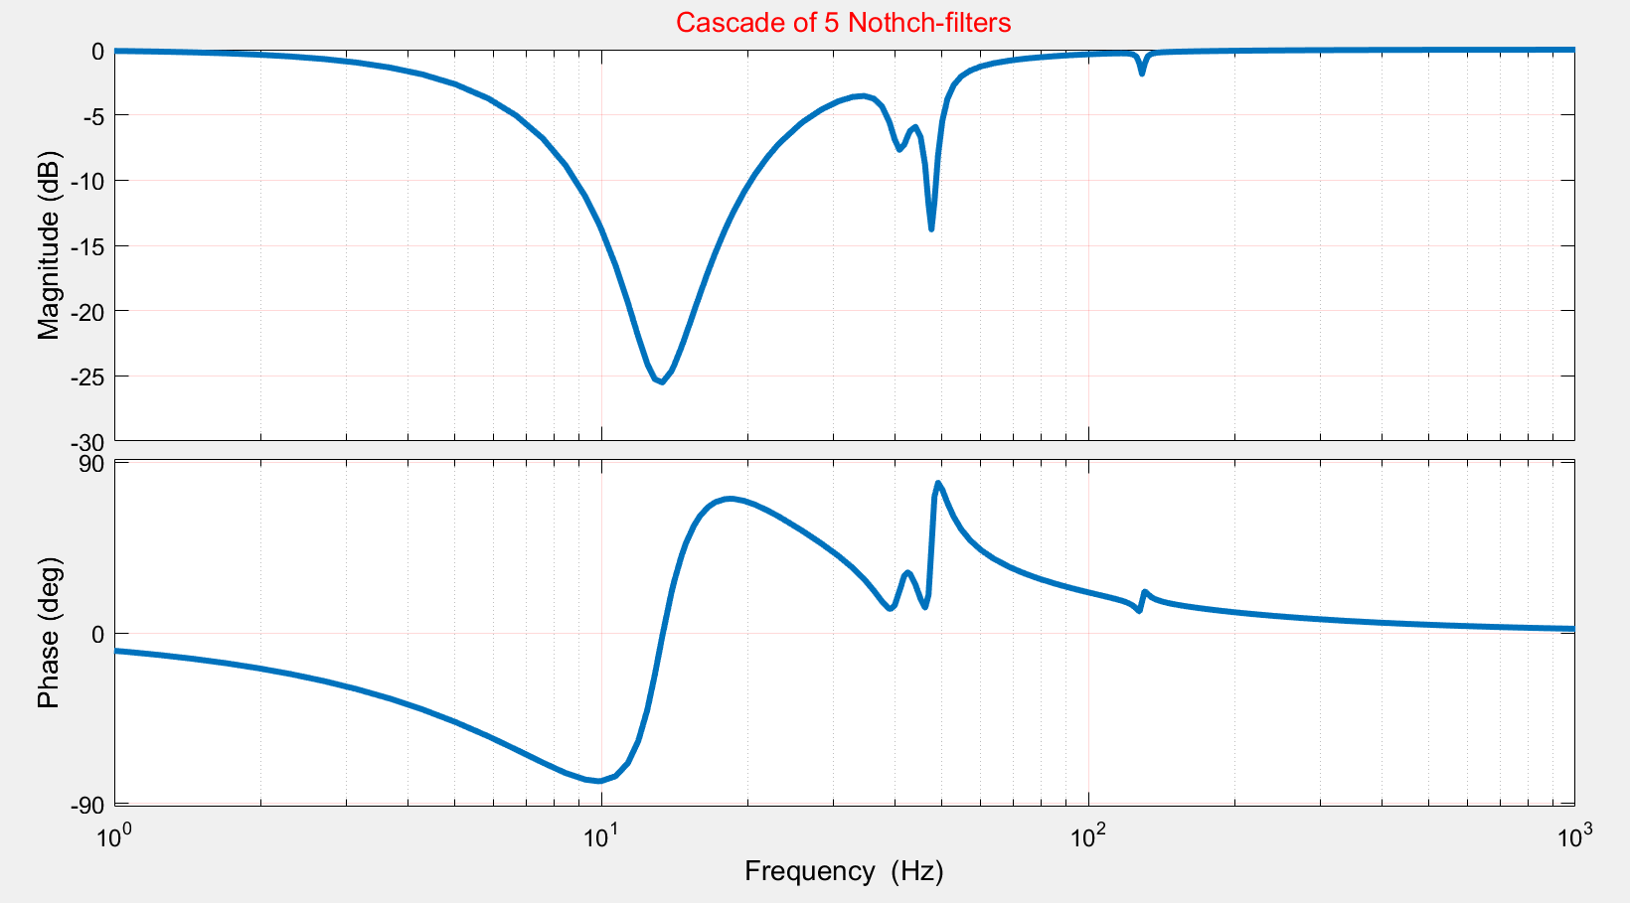
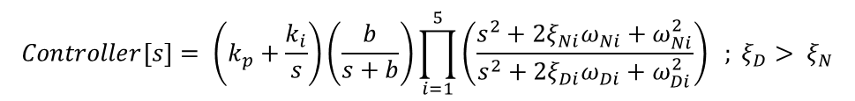
Control Configuration
E(t)
Y(t)
R(t)
+
-
Low-pass Filter
PI-Controller
Notch Filters
Beam Plants
Fig 9: The Control Configuration and the Plant
Controller Block | Describing Parameters | Target/Goal
Low Pass Filter | Corner-Frequency | High Frequency. Attenuation
PI-Controller | Proportional and Integral | Low-Freq Loop Shaping
Cascade of Notch Filters | Frequency, Height, and Width | Low/Mid-Freq. Error Rejection
Beam Plants | Data-Driven-Based | To represent the model of the Beam
$$Controller\left[s\right]= \left(k_{p}+\frac{k_{i}}{s}\right)\left(\frac{b}{s+b}\right)\prod_{i=1}^{5}{\left(\frac{s^{2}+2ξ_{Ni}ω_{Ni}+ω_{Ni}^{2}}{s^{2}+2ξ_{Di}ω_{Di}+ω_{Di}^{2}}\right) ; ξ_{D}> ξ_{N}}$$
Table 2: Control blocks and the descriptions
San José State University | A. Mounesisohi | May 2017 23

Slide 16
Control Optimization Objectives
Objective Function (f_{k}) |  | Desired Value | Weight
Min Gain Margin |  | 3 [dB] | 1
Min Phase Margin |  | 40[degree] | 1
Min Bandwidth |  | 4[Hz] | 1
Sensitivity TF upper-bound | 0-12 Hz | 6[dB] | 10
 | 12-500 Hz | 2[dB] | 10
Open-loop TF upper-bound | 0-12 Hz | 100[dB] | 10
 | 12-500 Hz | -10[dB] | 10
Table 3: the desired stability margins and op and sensitivity of the controller objectives and their weights.
San José State University | A. Mounesisohi | May 2017 23

Slide 17
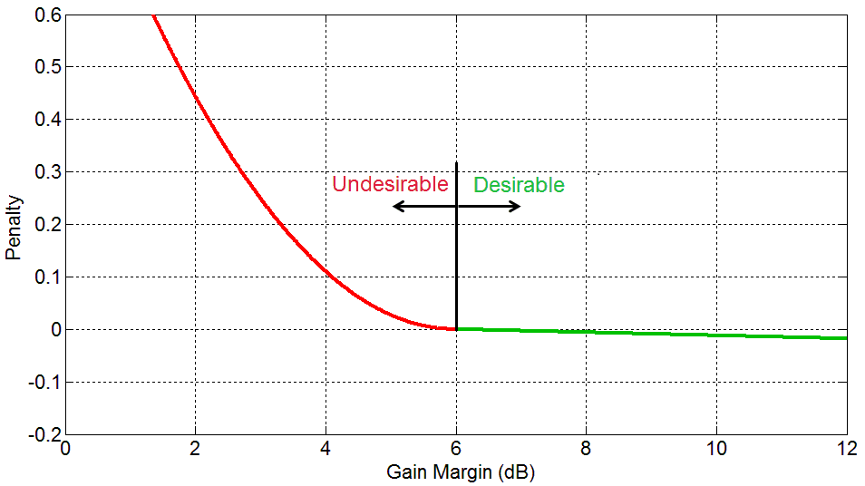
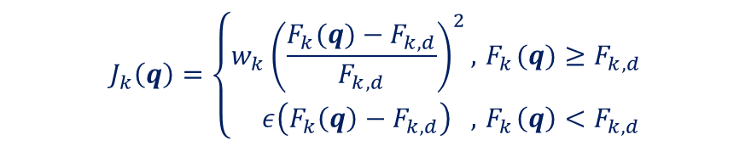
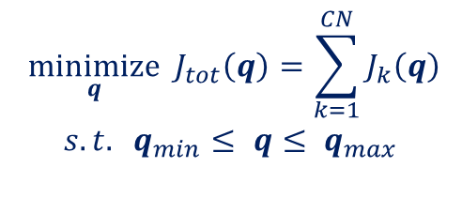
Control Optimization
$$\begin{matrix} \underset{q}{minimize}{{ J}_{tot}\left(q\right)}=\sum_{k=1}^{CN}{J_{k}\left(q\right)} \\ s. t. q_{min}≤ q≤ q_{max} \\ \end{matrix}$$
Control Objective:
$$J_{k}\left(q\right)=\left\{\begin{aligned}&{w_{k}\left(\frac{F_{k}(q)−F_{k,d}}{F_{k,d}}\right)}^{2}, { F}_{k}(q)≥F_{k,d} \\ & ε\left(F_{k}\left(q\right)−F_{k,d}\right) ,{ F}_{k}\left(q\right)<F_{k,d}\end{aligned}\right.$$
q: Control parameter vector
F_{k}: Control obj. (Gain margin, etc)
F_{k,d}: Desired objective value
w_{k}: Objective weight
ϵ: Small positive gain
Penalty Function:
Quadratic penalty
Example:
Small incentive
Figure 14 : The graph of quadratic penalty function.
San José State University | A. Mounesisohi | May 2017 23

Slide 18
Optimization Logic
Optimization is based on a neighborhood search algorithm.
Converges to local minimum (requires a good initial design).
Optimization variables are constrained using the same quadratic penalty function with the following lower/upper bounds:
Optimization Variable | Lower Bound | Upper Bound
Kp | 1 | 1e6
Ki | 1 | 1e6
b [Hz] | 1 | 100
Notch Filter Freq [Hz] | 1 | 500
Notch Filter Width [Hz] | 1 | 20
Notch Filter Depth [dB] | 1 | 35
Table 4: The lower bound and upper bound of the parameters for optimization.
San José State University | A. Mounesisohi | May 2017 23

Slide 19
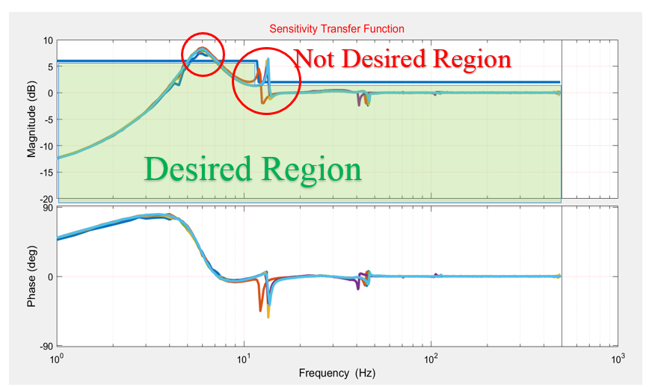
SENSITIVITY TF FOR THE HAND TUNED CONTROLLER
San José State University | A. Mounesisohi | May 2017 15
RESULTS
Figure 10: Closed-loop transfer function for all the plants.

Slide 20
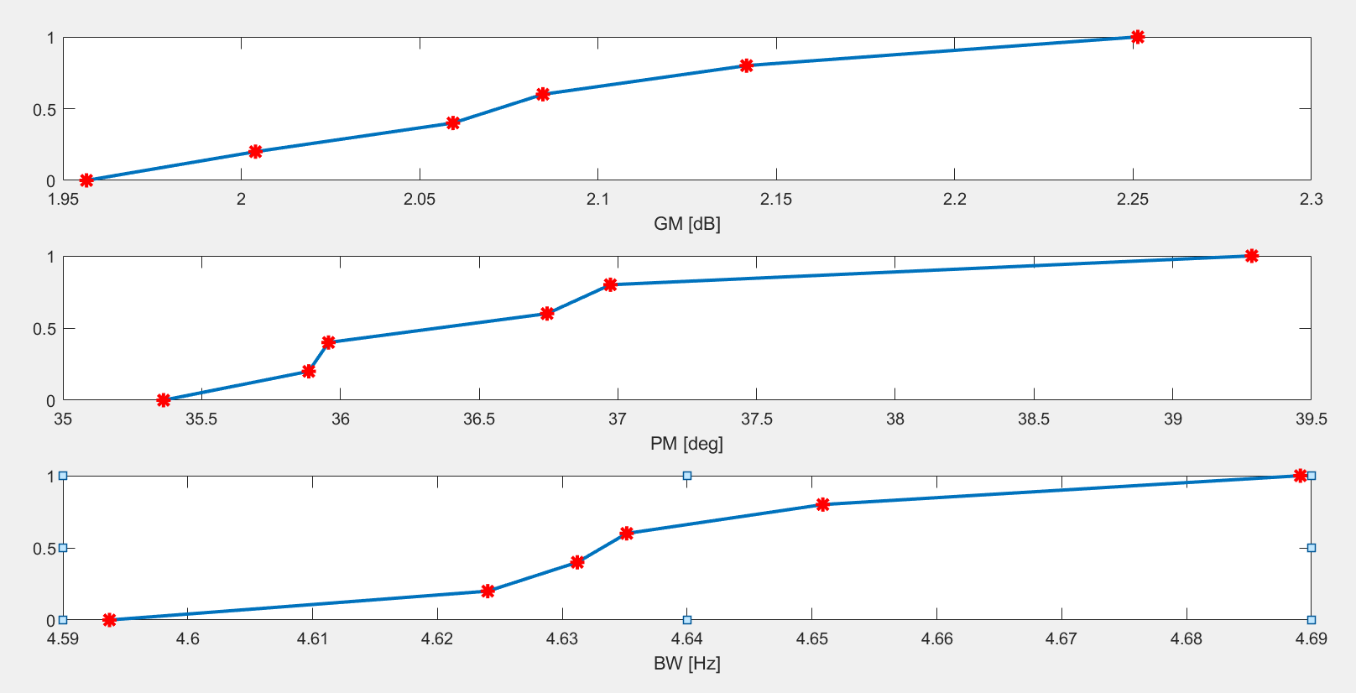
GM, PM, AND BW OF THE HAND TUNED CONTROLLER
San José State University | A. Mounesisohi | May 2017 16
Figure 11: Sorted GM, PM, and BW, for all the open-loops’ transfer functions.

Slide 21
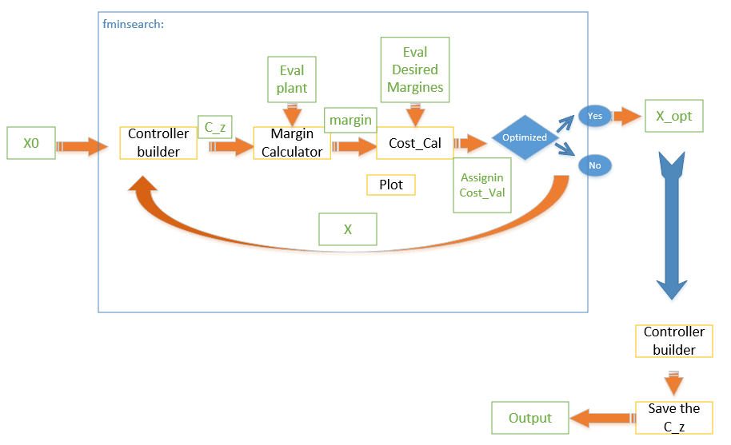
OPTIMIZATION ALGORITHM
San José State University | A. Mounesisohi | May 2017 18
Figure 12: The optimization flow-chart.

Slide 22
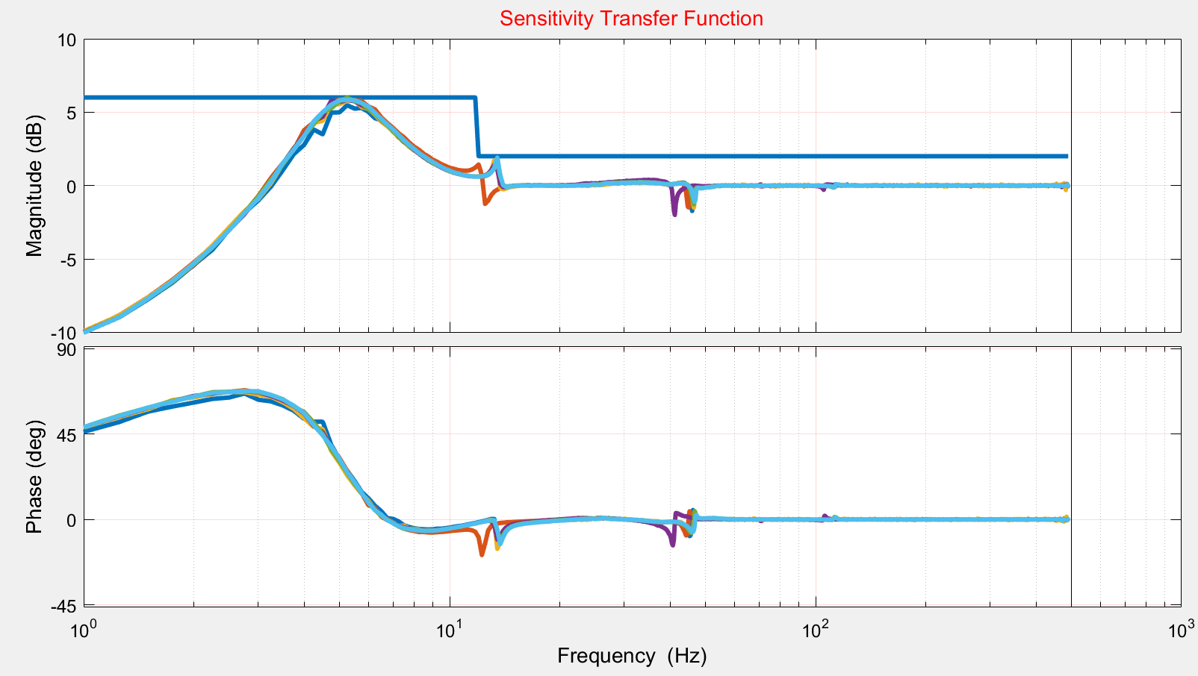
SENSITIVITY TF FOR THE OPTIMIZED CONTROLLER PARAMETERS
San José State University | A. Mounesisohi | May 2017 20
Figure 13: The sensitivity transfer function after control optimization

Slide 23
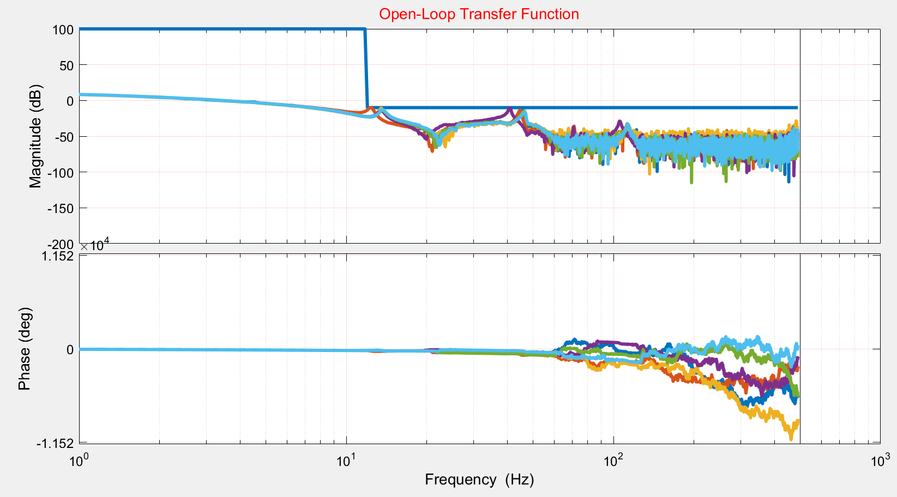
OPEN-LOOP TF FOR THE OPTIMIZED CONTROLLER PARAMETERS
San José State University | A. Mounesisohi | May 2017 21
DISCUSSION
Figure 14: The open-loop transfer function after control optimization

Slide 24
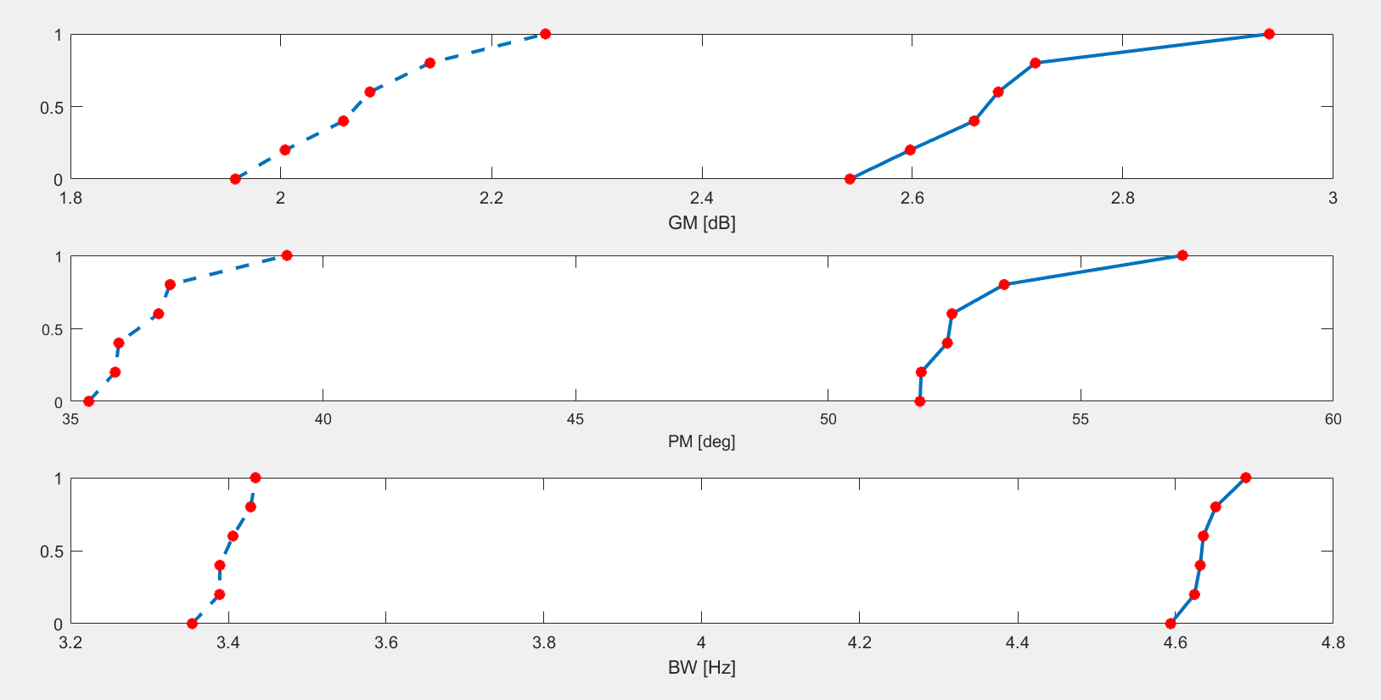
GM, PM, AND BW FOR THE OPTIMIZED CONTROLLER PARAMETERS
San José State University | A. Mounesisohi | May 2017 22
manual-Tuned
Optimized
Manual-Tuned
Optimized
Manual-Tuned
Optimized
Figure 15: The GM, PM, and BW values before and after control optimization

Slide 25
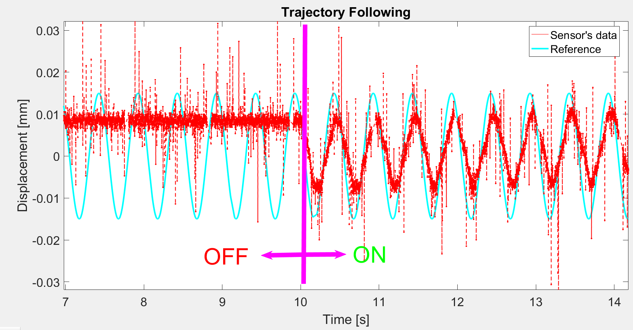
TRAJECTORY TRACKING SINUSOIDAL INPUT
San José State University | A. Mounesisohi | May 2017 24
Figure 16: The sinusoidal response trajectory tracking.

Slide 26
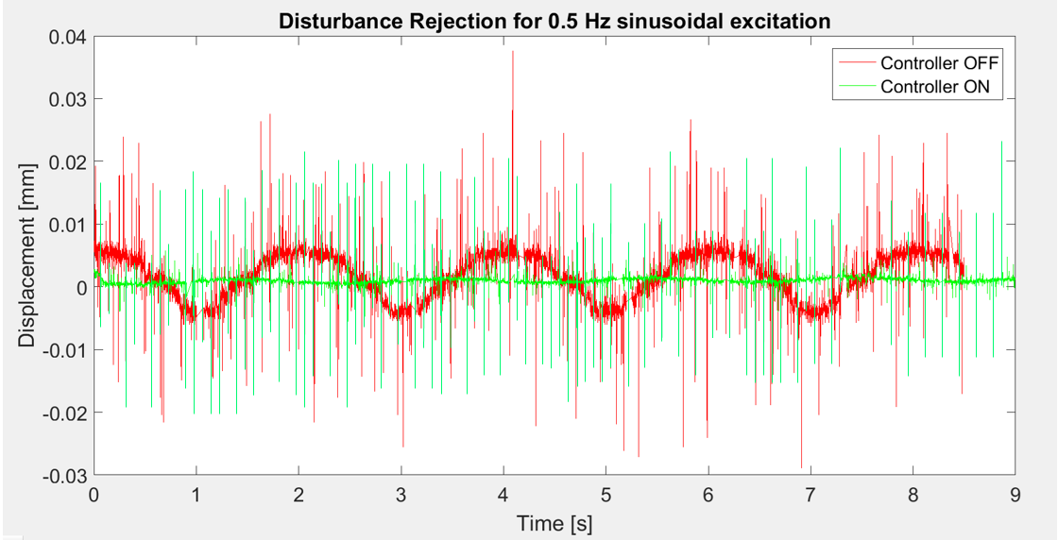
DISTURBANCE REJECTION
San José State University | A. Mounesisohi | May 2017 25
Figure 17: Disturbance Rejection presentation for controller is off and on.

Slide 27
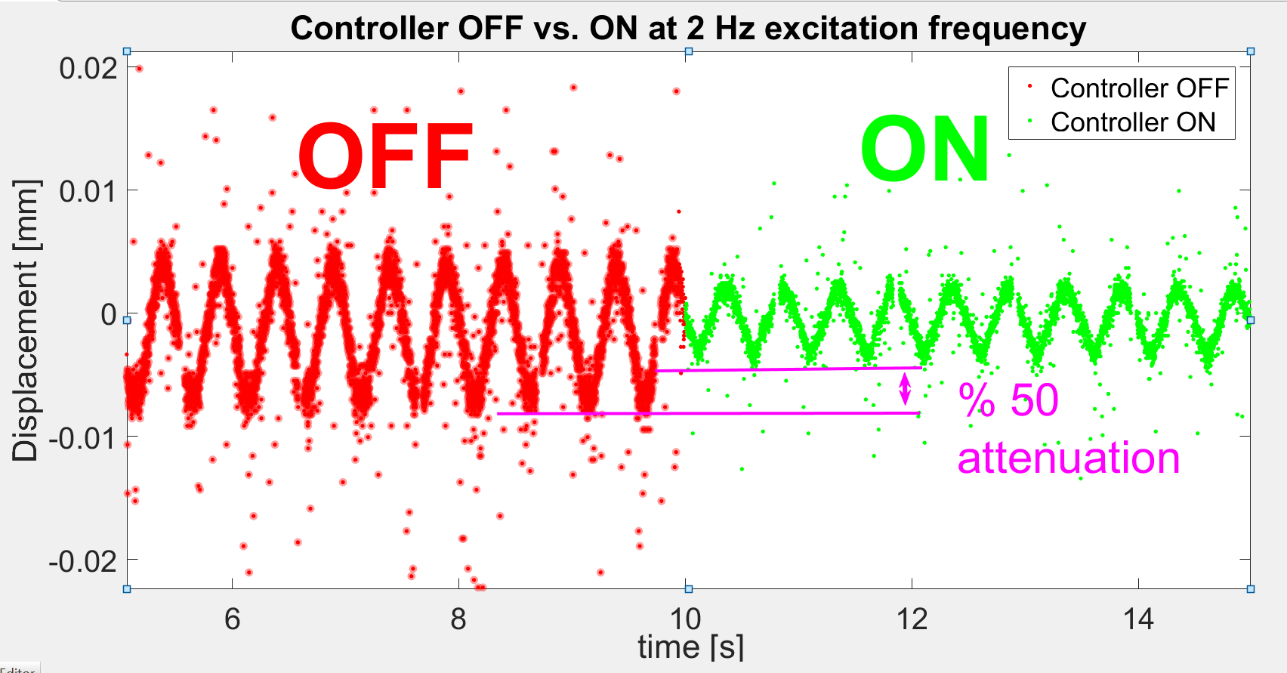
DISTURBANCE REJECTION
San José State University | A. Mounesisohi | May 2017 26
Figure 18: Disturbance Rejection presentation for controller is off and on.

Slide 28
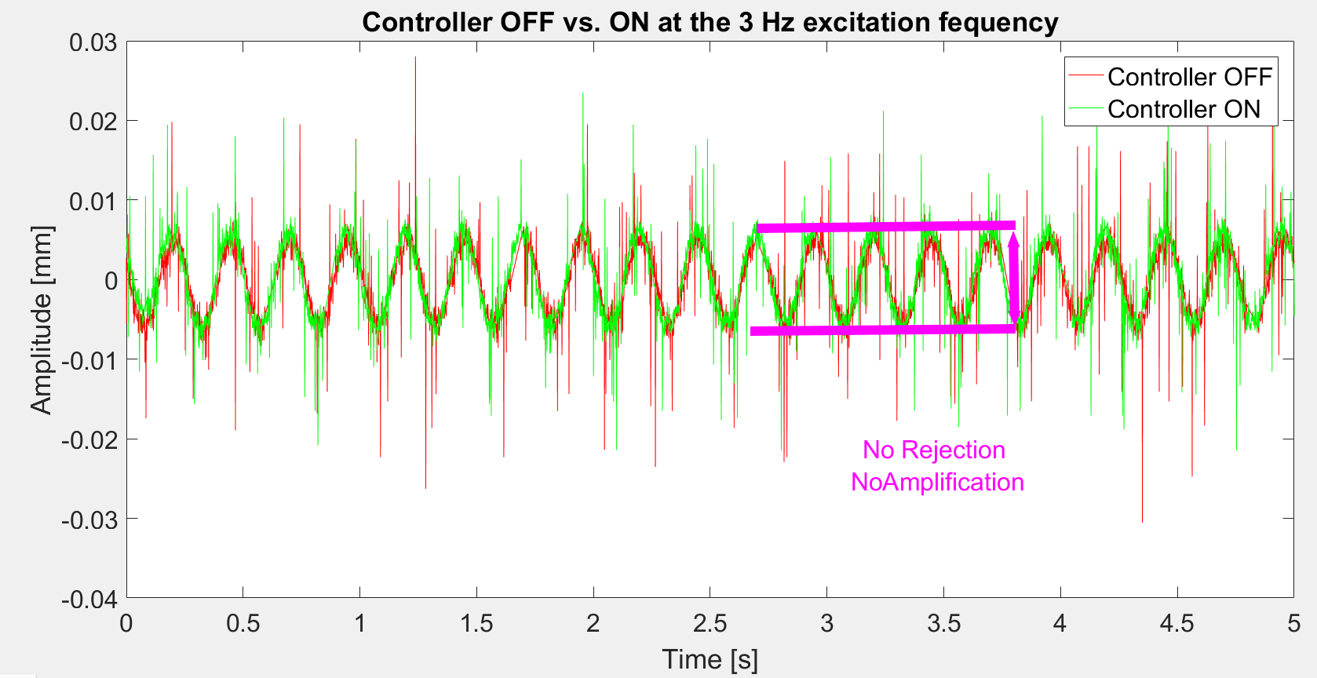
DISTURBANCE REJECTION
San José State University | A. Mounesisohi | May 2017 27
Figure 19: Disturbance Rejection presentation for controller is off and on.

Slide 29
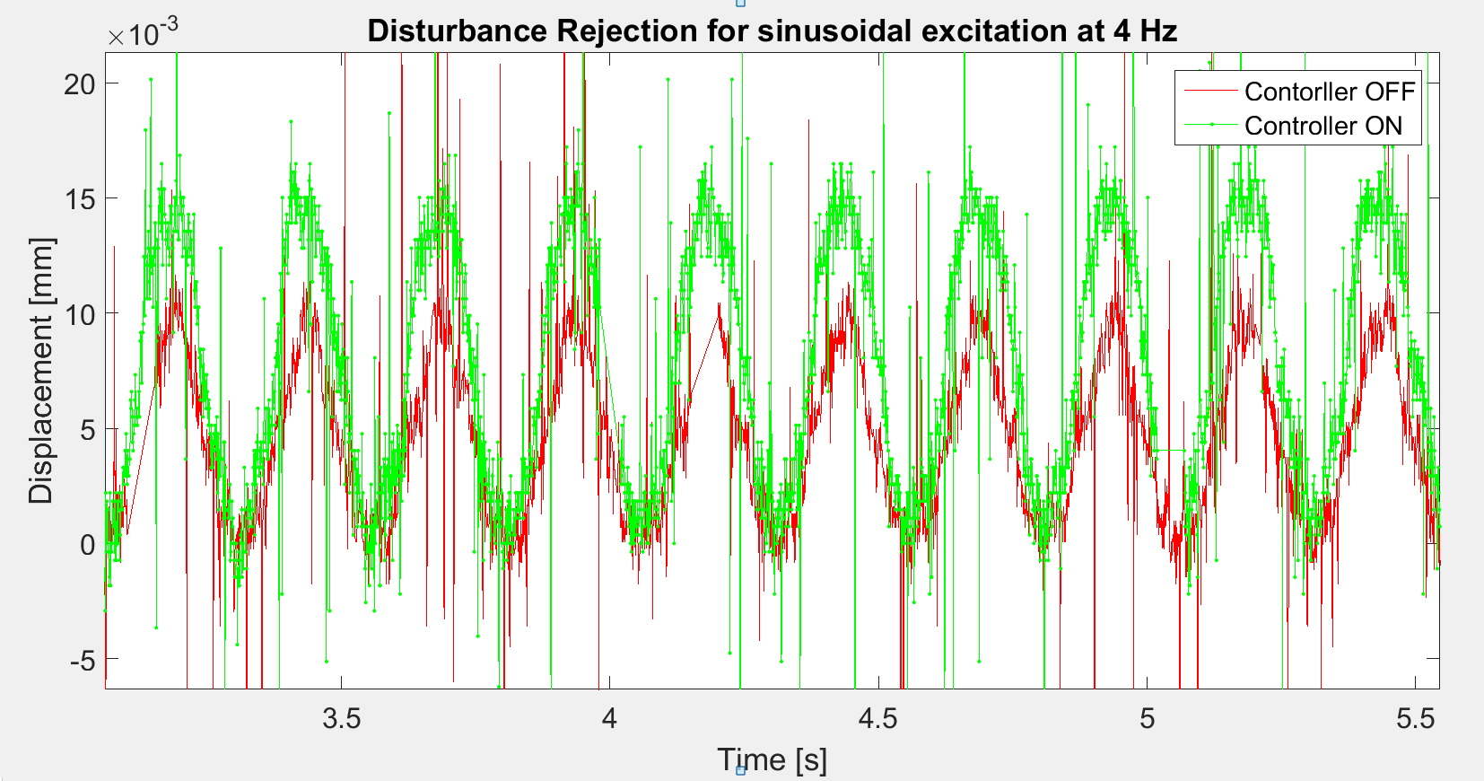
DISTURBANCE REJECTION
San José State University | A. Mounesisohi | May 2017 28
Figure 20: Disturbance Rejection presentation for controller is off and on.

Slide 30
SUMMARY AND CONCLUSION
San José State University | A. Mounesisohi | May 2017 29
An experimental setup was developed comprising piezoelectric actuators and a laser sensor.
The frequency response data was provided through the data acquisition and behavior of LTI.
A data-driven controller is designed in the s-domain and then transferred into the z-domain.
The controller was optimized using Nelder-Mead search neighborhood to satisfies the control design targets such as closed-loop margins, open-loop, and sensitivity overall shaping.
The Final controller was implemented and the effectiveness of the method is evaluated .
The results of the disturbance rejection and trajectory following are matched with the sensitivity frequency response data.

Slide 31
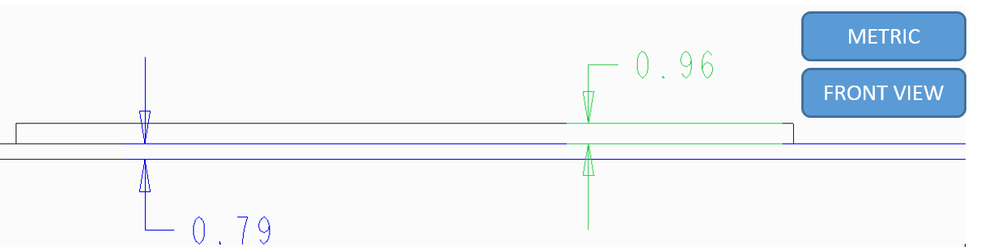
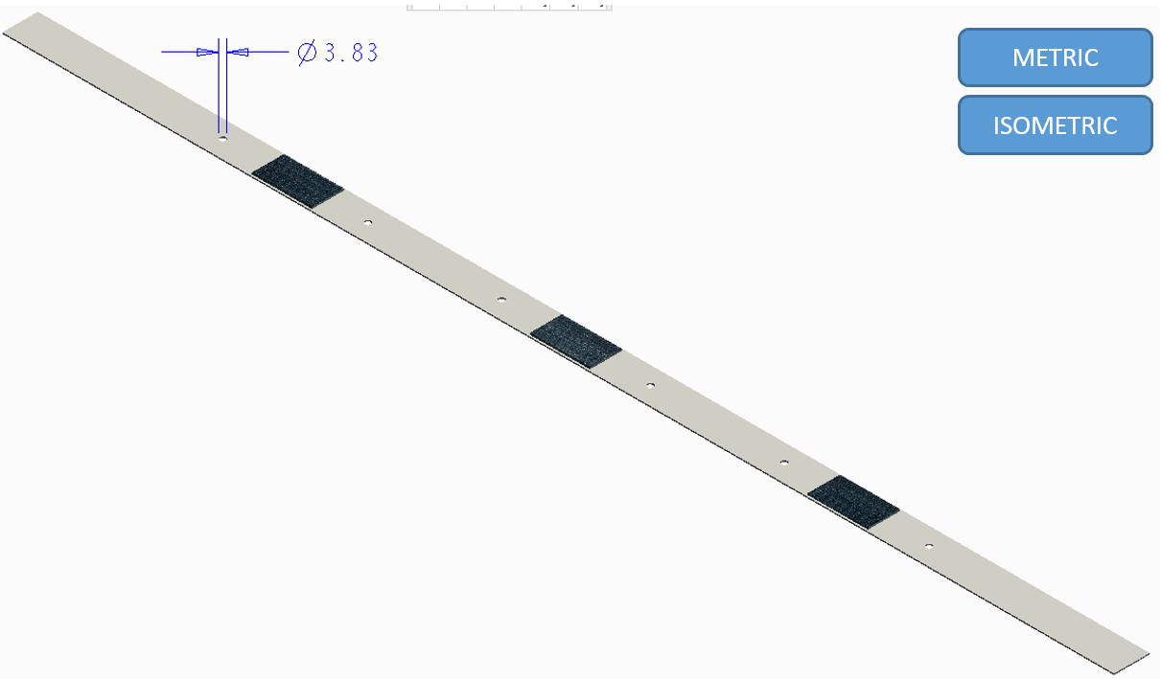
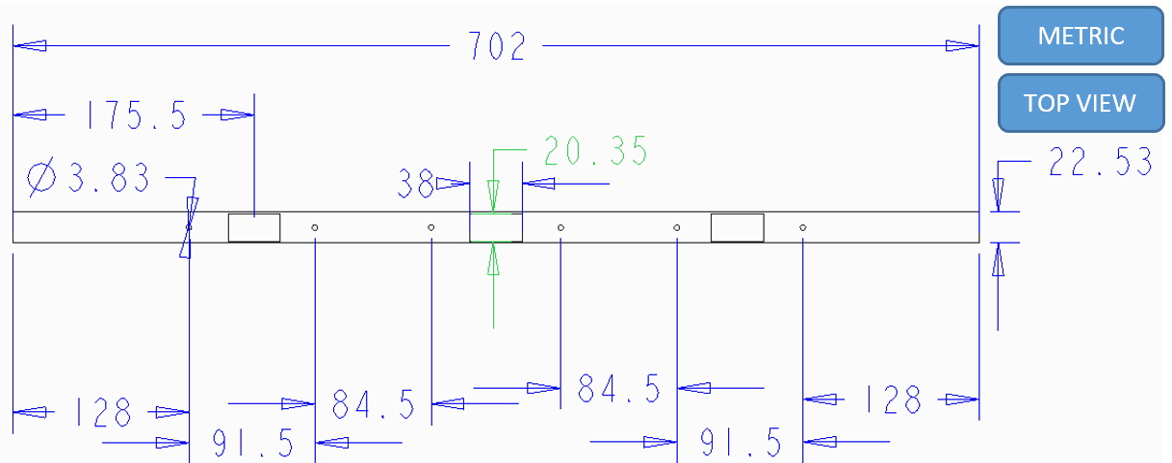
APPENDIX
PLANT CHARACTERIZATION
Using Finite Element Analysis
San José State University | A. Mounesisohi | May 2017 30
METHODOLOGY
Model the Clamped-Clamped Beam in Creo , a CAD software.
Figure 1-2: The front view of the experiment beam (partially view)
Figure 1-3: The isometric view of the beam integrated with the piezo actuators and the holes.
Figure 1-1- Top view of the experiment beam from end to end.

Slide 32

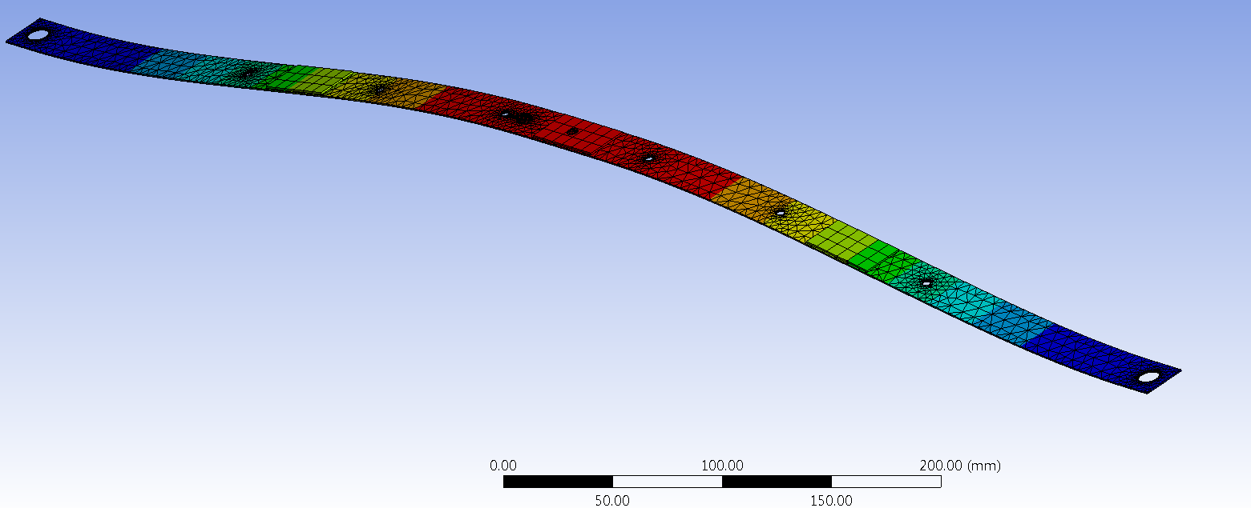
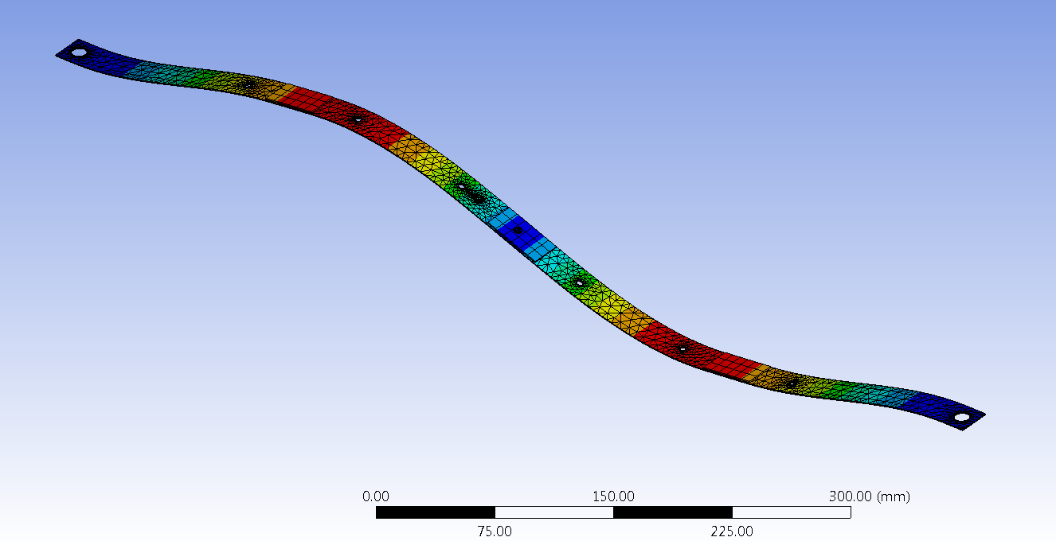
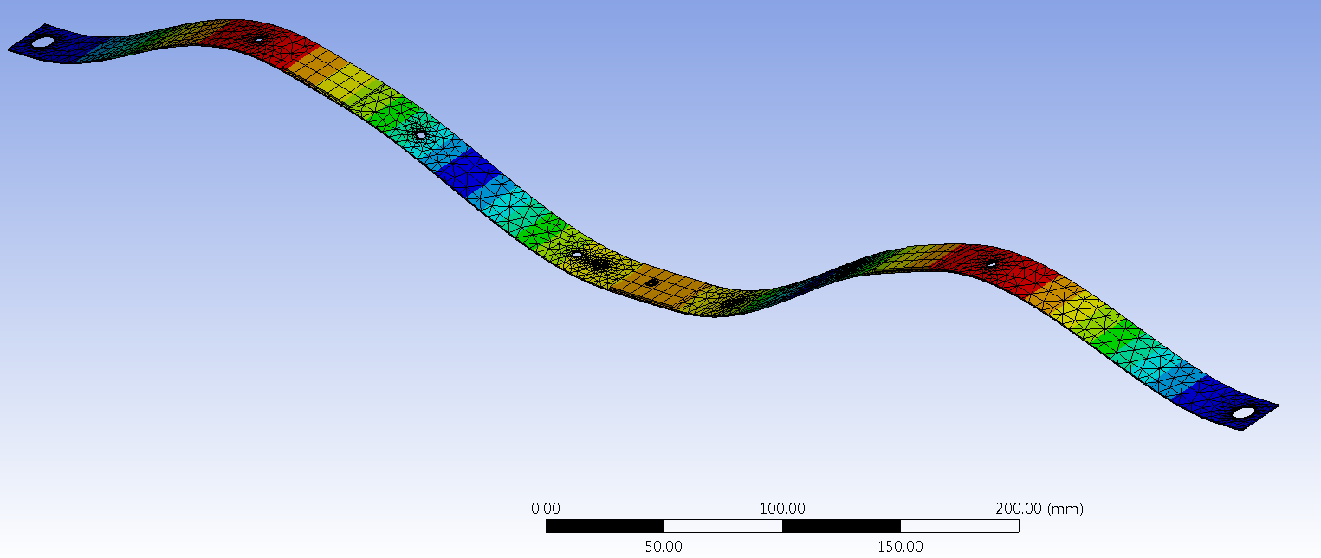
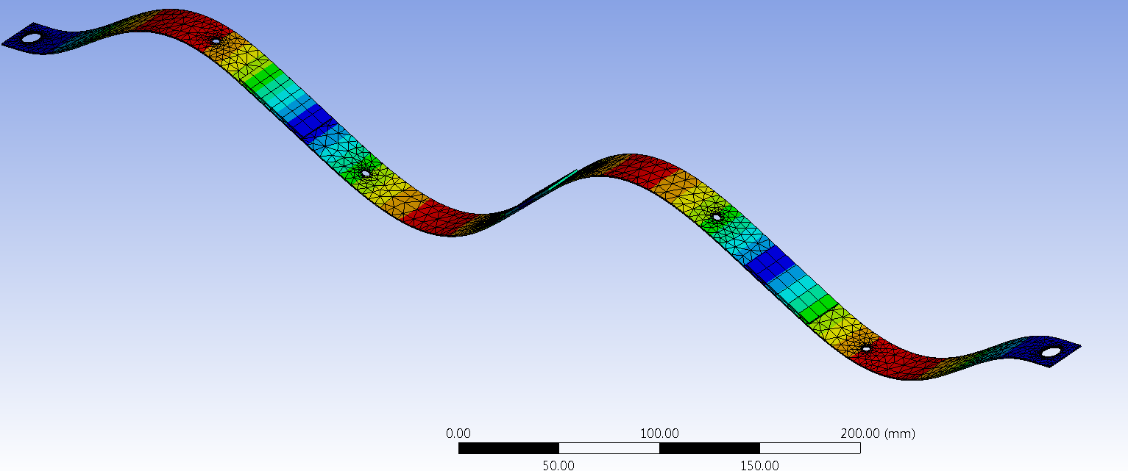
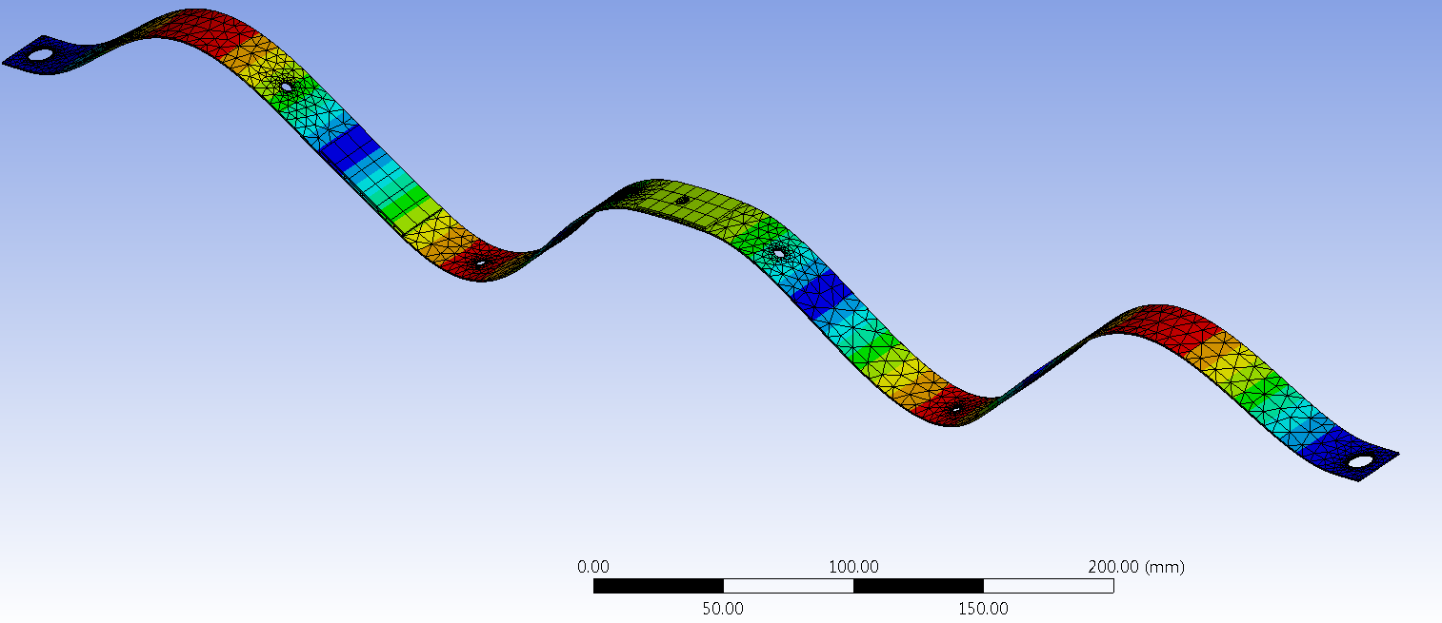
APPENDIX
PLANT CHARACTERIZATION, Ansys Harmonic Response
San José State University | A. Mounesisohi | May 2017 31
METHODOLOGY
First Mode 13.614 Hz
Second Mode
Third Mode 79.789 Hz
Second Mode 38.546 Hz
The experimental | Ansys
14 Hz | 14 Hz
44 Hz | 39 Hz
113 Hz | 80 Hz
Fourth Mode 128.95 Hz
Fifth Mode 202.25 Hz
Figure 1-4: Showing Ansys modal analysis results in the first five modes
Table5: The natural frequency comparing the experimental and Ansys

Slide 33
Thank you

Slide 34
Backup Slides
Initial controller Margins |  | Values for the all Plants
Gain Margin |  | (1.95-2.25) [dB]
Phase Margin |  | (35-40) [degree]
Bandwidth |  | (4.6-4.7) [Hz]
Sensitivity TF Maximum | 0-12 Hz | 8.52 [dB]
 | 12-500 Hz | 6.43[dB]
Open-loop TF Maximum | 0-12 Hz | 11.2[dB]
 | 12-500 Hz | -3.4[dB]
the initial stability margins and op and sensitivity for the manual-tuned controller

Slide 35
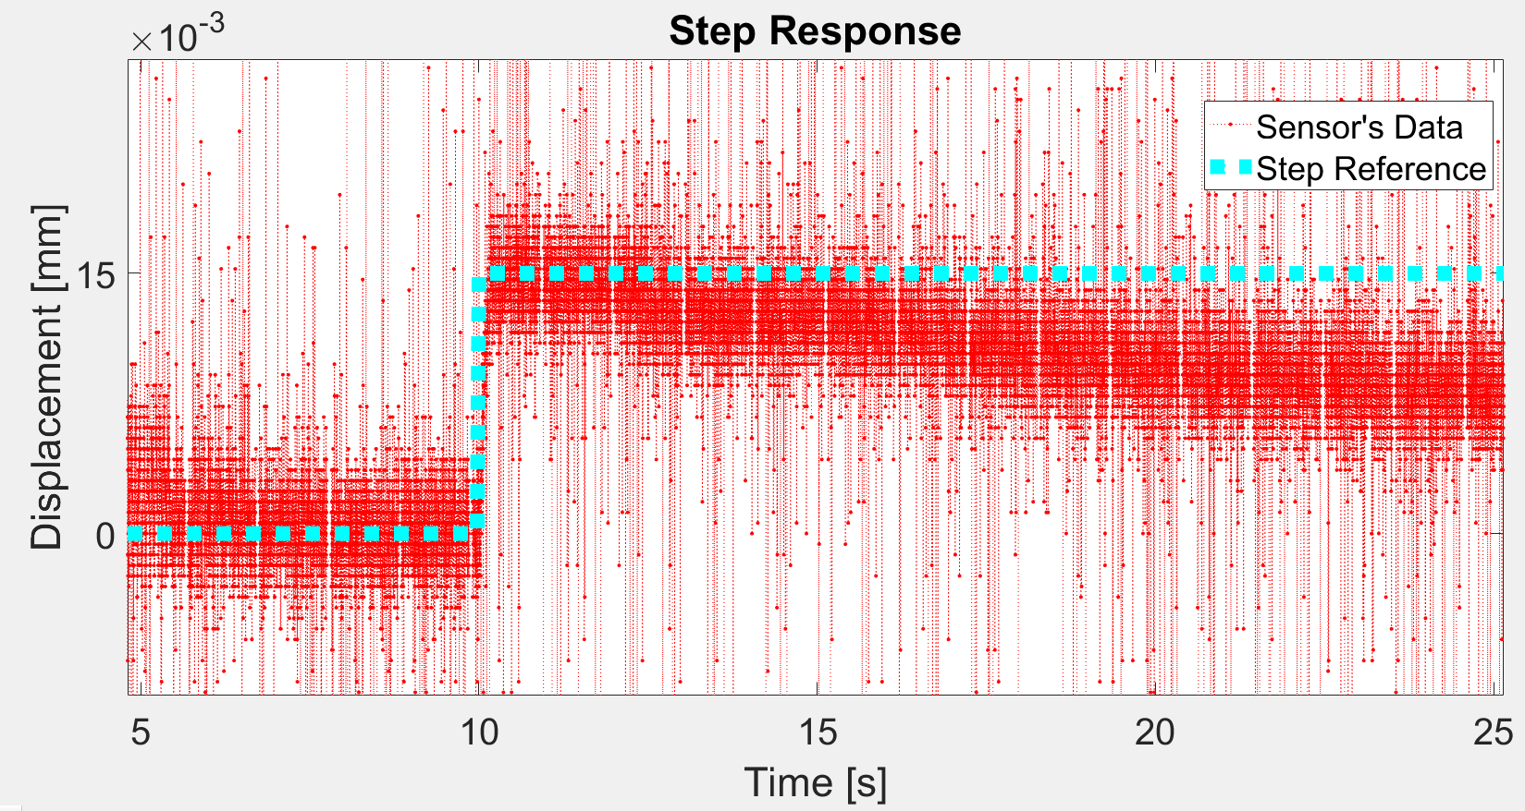
TRAJECTORY TRACKING OF A STEP INPUT
San José State University | A. Mounesisohi | May 2017 23
The step response trajectory tracking.

Slide 36
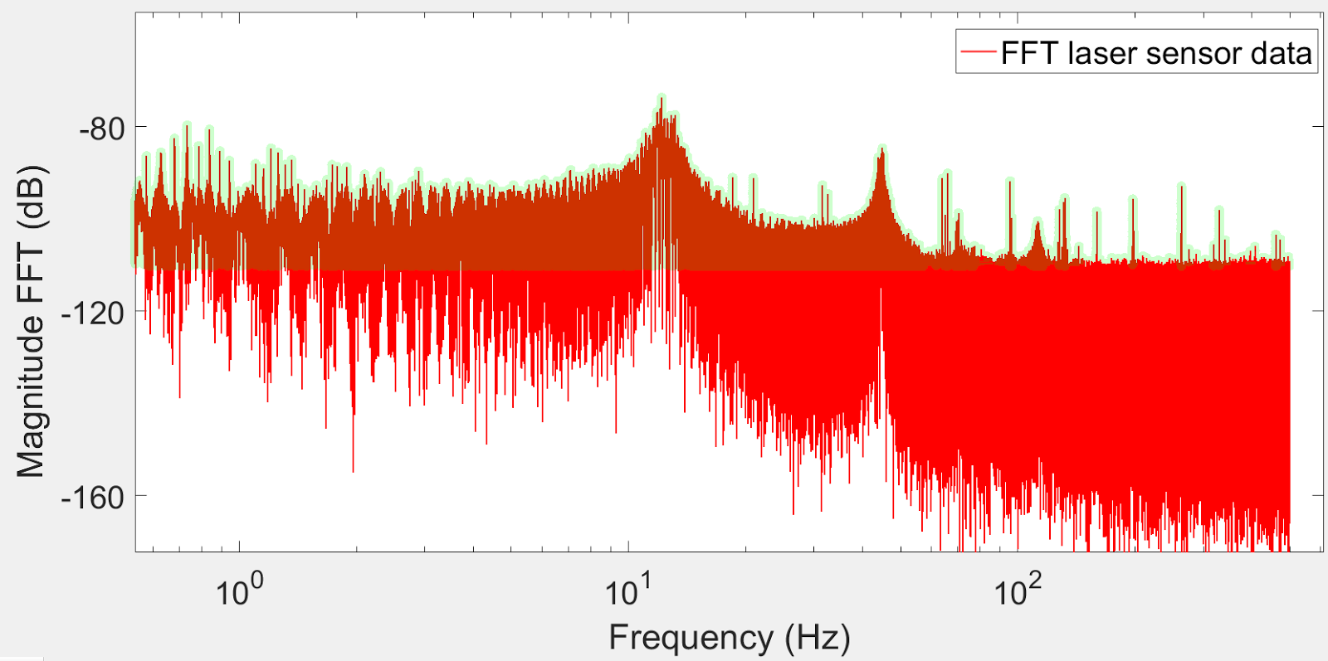
Characterizing Using Fast-Fourier-Transform
Fast-Fourier-transform of output over input
San José State University | A. Mounesisohi | May 2017 23

Slide 37
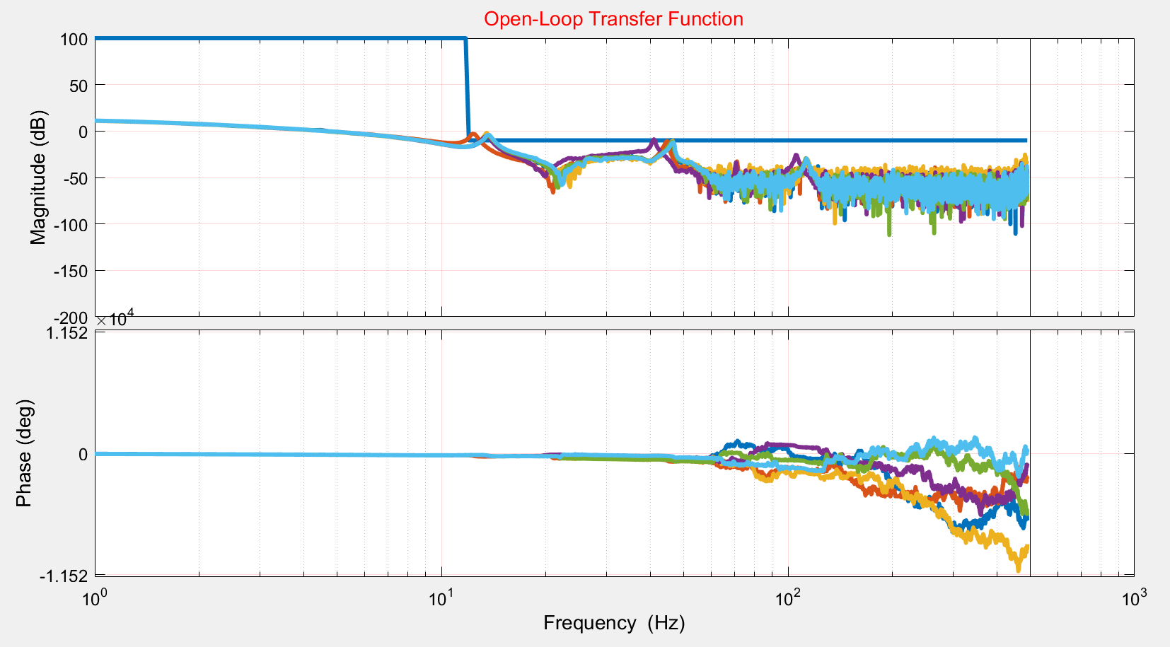
OPEN LOOP TF FOR THE HAND TUNED CONTROLLER (DL)
San José State University | A. Mounesisohi | May 2017 14
Open-loop transfer function for all the plants.

Slide 38
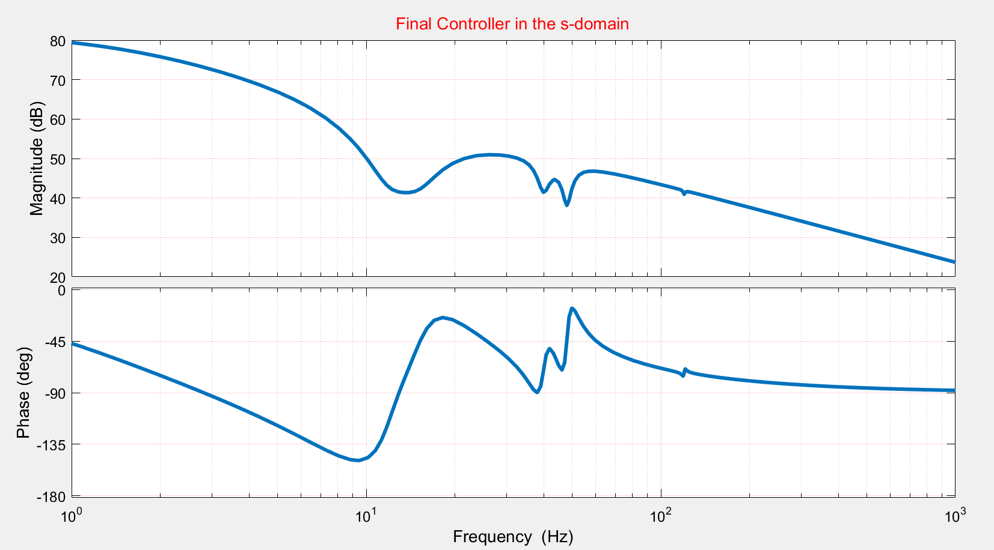
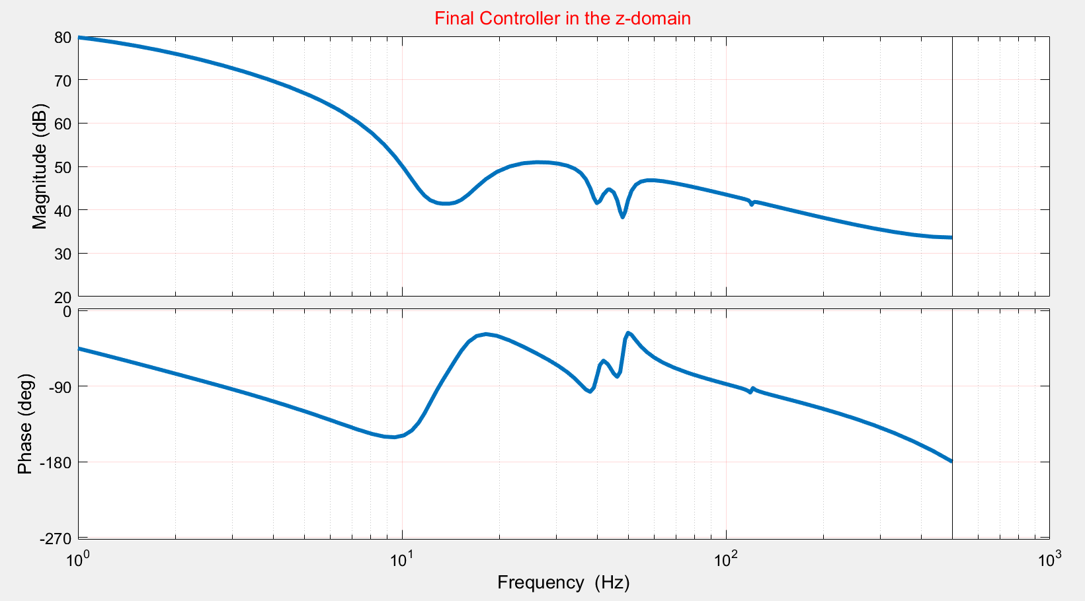
DISCRETIZATION TRANSFORMATION (DL)
San José State University | A. Mounesisohi | May 2017 13
S-Domain
z-Domain
Frequency response of the final controller in the s-domain
Frequency response of the final controller in the z-domain (descretized)

